Slide 1
Leaf shape vocabulary

Slide 2
Learning outcomes
I can describe a leaf using specific vocabulary.
I can recognise a leaf based on a description.

Slide 3
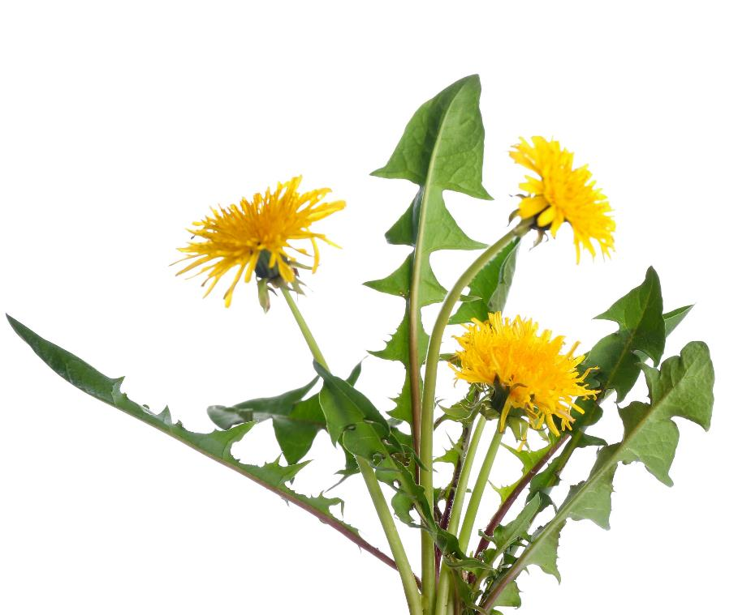
Have you seen this plant before?
What do you know about it?
  What is it called?
  Where do you see it?
  Can you eat it?
Dandelions have been used as food and medicine for a long time!

Slide 4
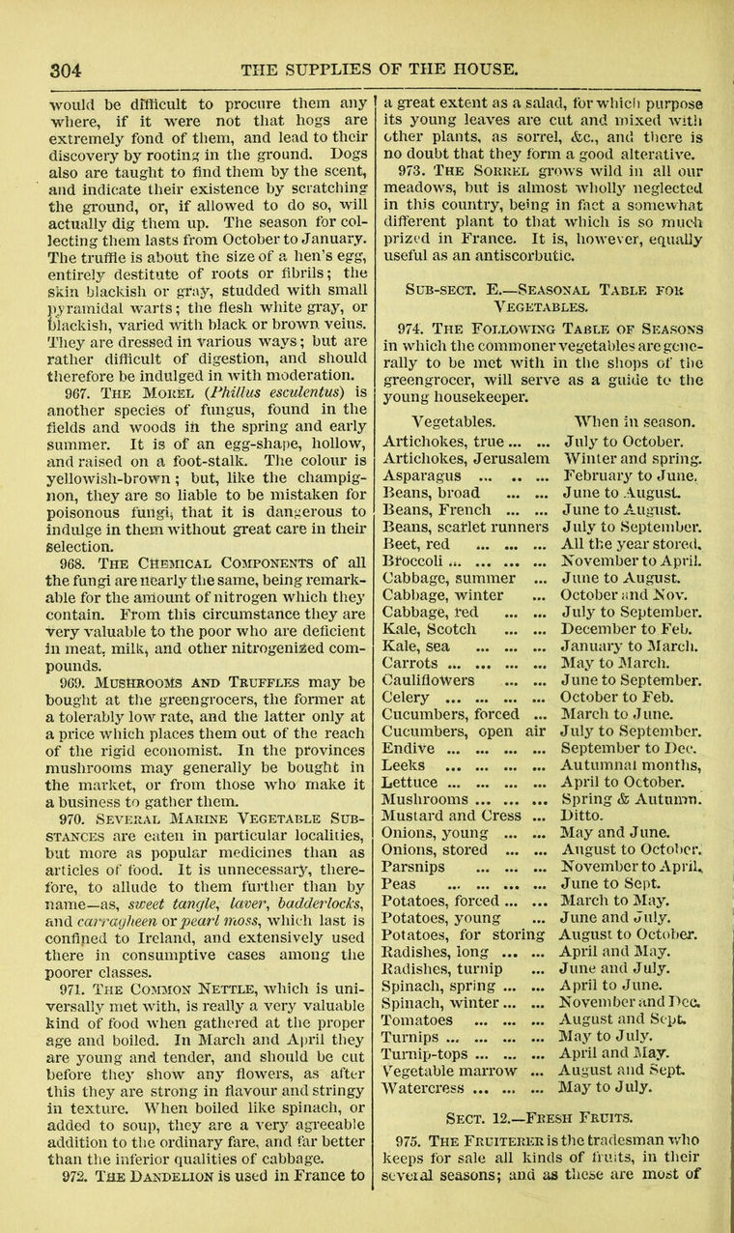
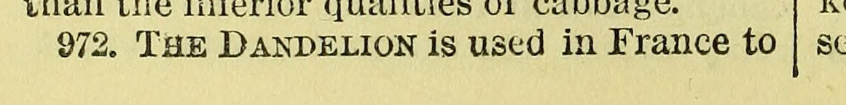
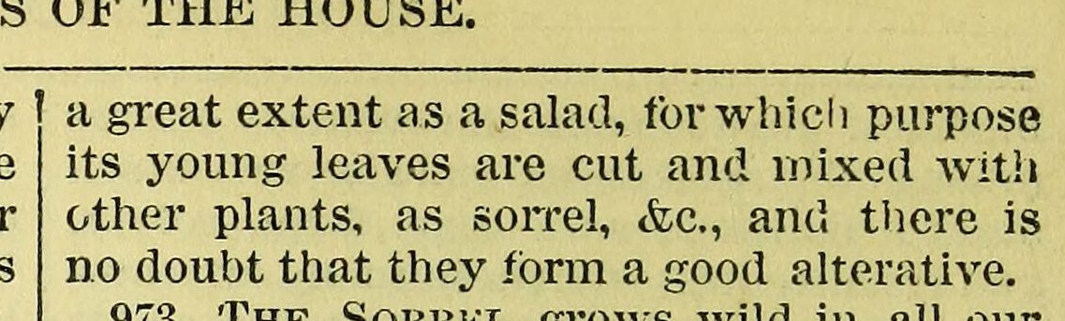
Historical dandelion recipes
A manual of domestic economy by J.H. Walsh... assisted in various departments by a committee of ladies.
Source: Wellcome Collection.
Notes:
What might happen if people ate something that looks like a dandelion, but isn’t a dandelion?
Being able to recognise common plants can be important because it can prevent you from getting sick from eating the wrong thing.

Slide 5
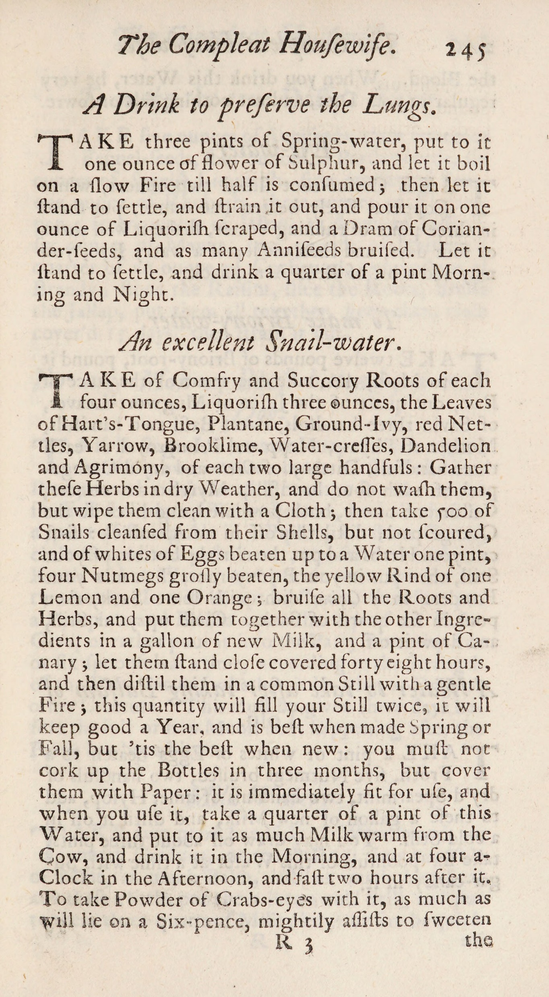
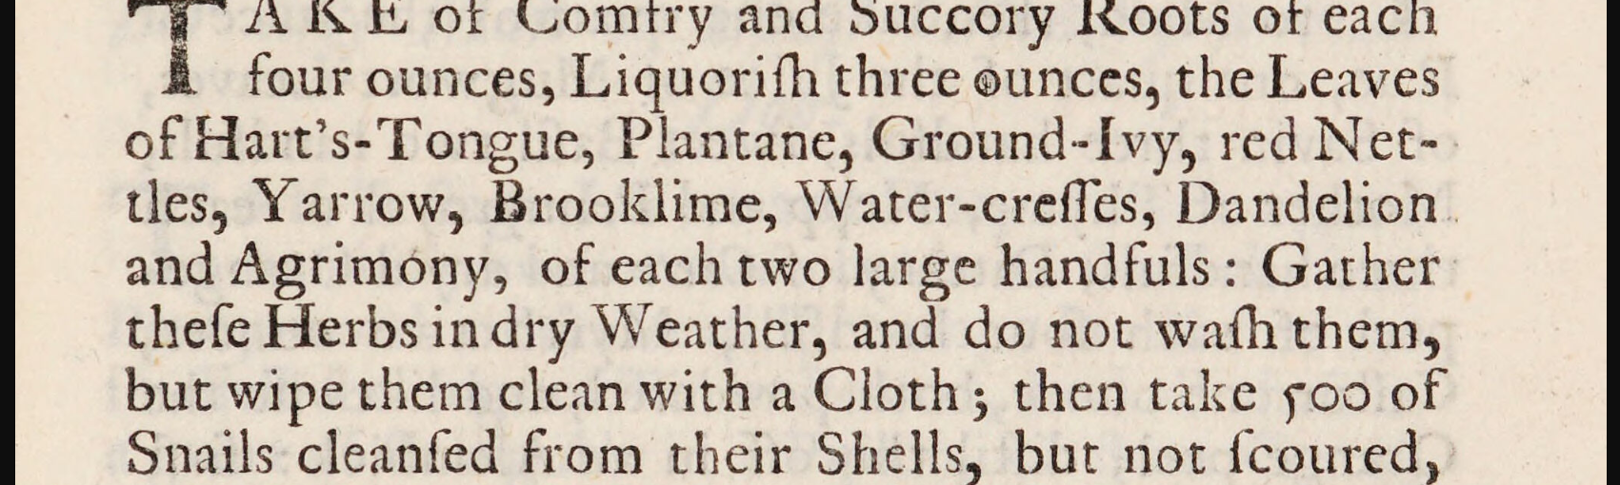
Dandelion medicine
Snail-water
A medicine taken for coughs and breathing problems.
The compleat housewife. By E---- S---- [i.e. Eliza Smith]. 1734 Source: Wellcome Collection.
Notes:
Lots of our medicines originally came from plants.
It is important to be able to recognise some common plants because some can make people sick.

Slide 6
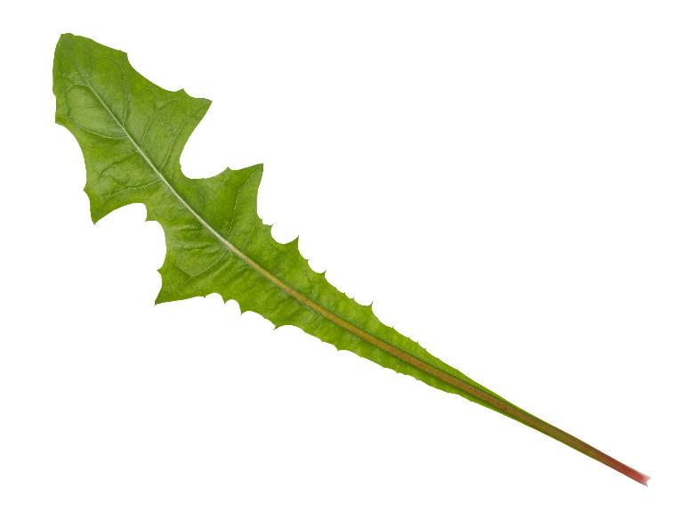
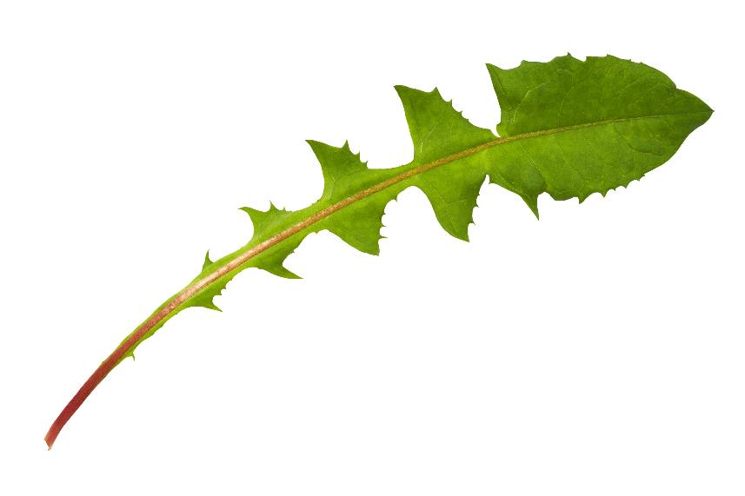
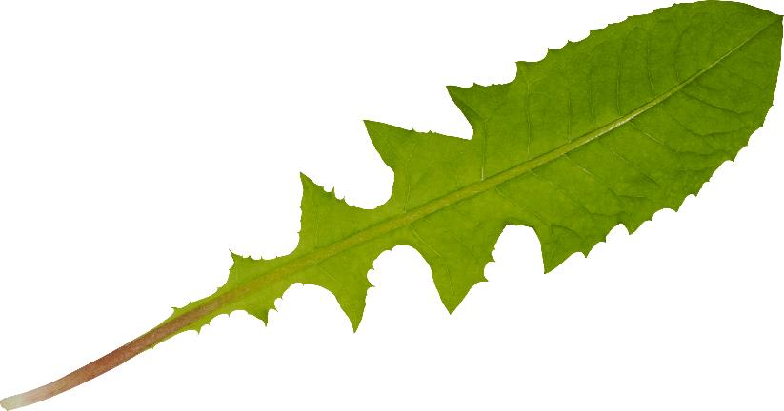
How can we recognise a dandelion?
What do these dandelion leaves have in common?
Notes:
Learners list as many similarities as they can.
When learners have run out of ideas, reveal that all of them are dandelion leaves.

Slide 7
Can we create one description that works for all three leaves?
Notes:
Use the similarities learners identified to put together a description that works for all three leaves.
This challenge is something the people who study nature need to deal with all the time. It's very rare that every individual of a type of living thing looks the same.

Slide 8
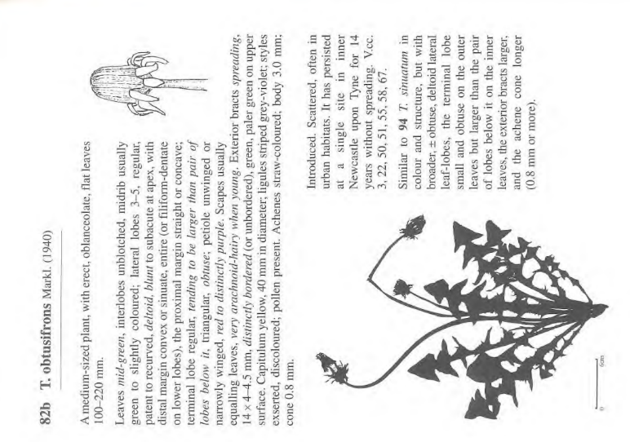
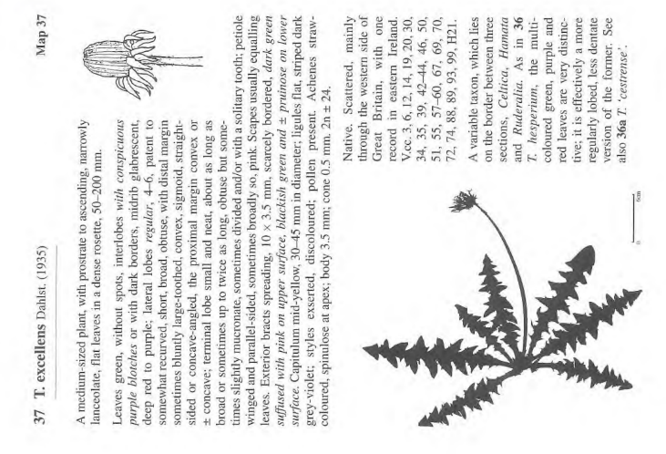
There are more than 200 species of dandelion in the UK!
Some of them are very rare and are only found in small areas.
Dandelions are very difficult to tell apart without looking very closely and referring to very detailed descriptions of each species.
Pages from Dandelions of Great Britain and Ireland. (1997). Dudman, A.A.; Richards, A.J.
Notes:
In these images “T.” is short for Taraxacum, the scientific name for the genus that dandelions belong to. It is thought that this comes from an Arabic word meaning “bitter herb”.
obtusifrons means ‘blunt’ forehead and refers to the shape of the flower head when it is closed.
excellens means ‘excellent’. What makes this type of dandelion excellent?

Slide 9
Parts of a leaf
Tip
Edge
Vein
Stalk
Leaf base

Slide 10
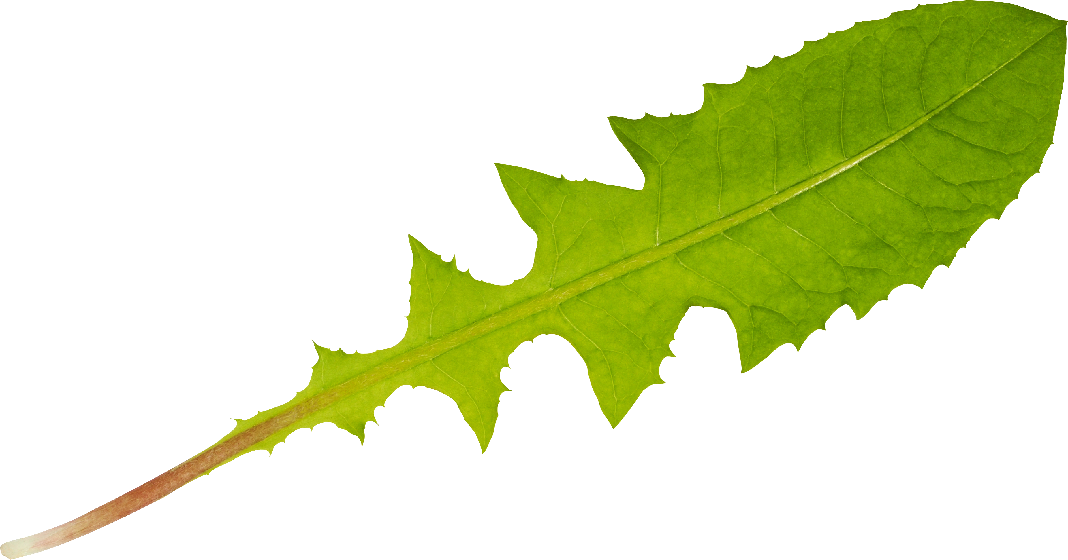
Parts of a leaf
Edge
Tip
Stalk
Veins
Leaf base

Slide 11
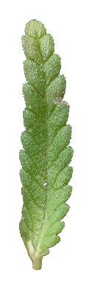
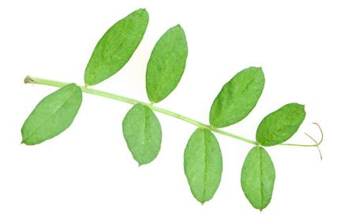
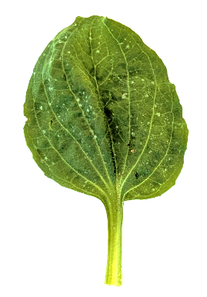
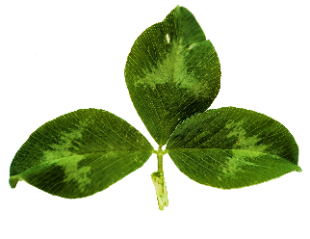
Leaf shapes
Simple |  |  | Compound
Illustration | Examples |  | Illustration | Examples
Simple leaves have one broad area on a stalk. |  |  | Compound leaves have many broad areas on the stalk. Each broad area is called a leaflet.

Slide 12
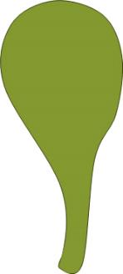

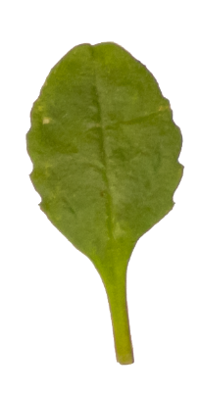
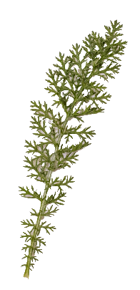
Leaf shapes
Narrow | Oval | Spoon | Fern or feather

Slide 13
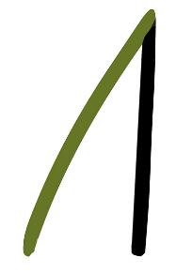
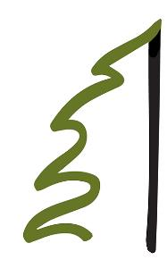
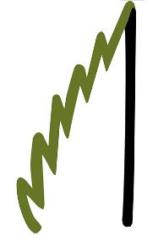
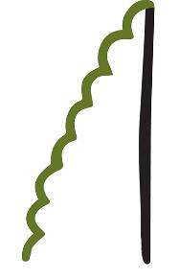
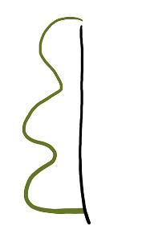
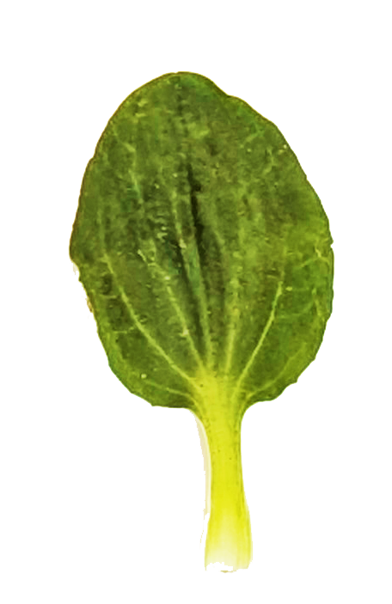
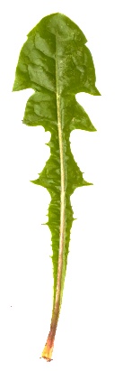
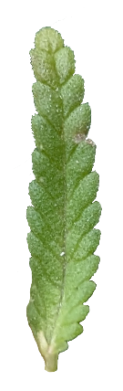
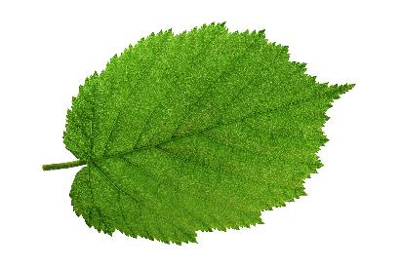
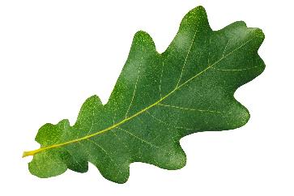
Leaf edges
Smooth | Toothed | Serrated | Bumpy | Lobed

Slide 14

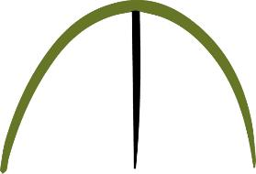
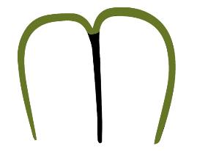
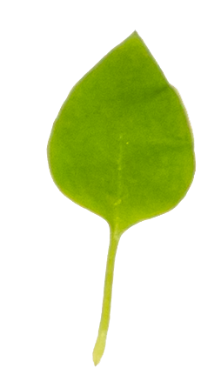
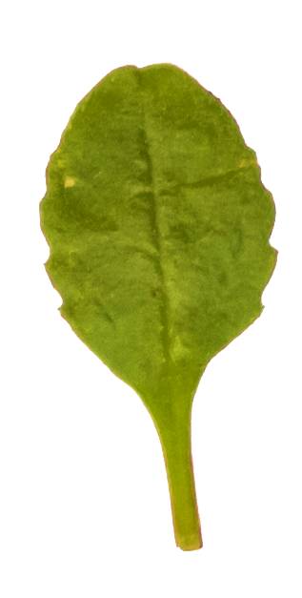
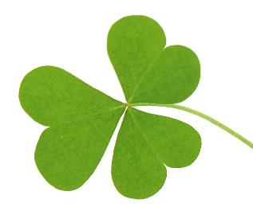
Leaf tips
Pointed | Rounded | Heart-shaped

Slide 15


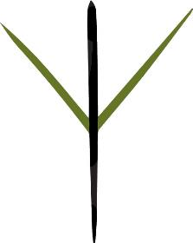
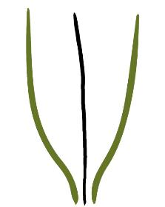
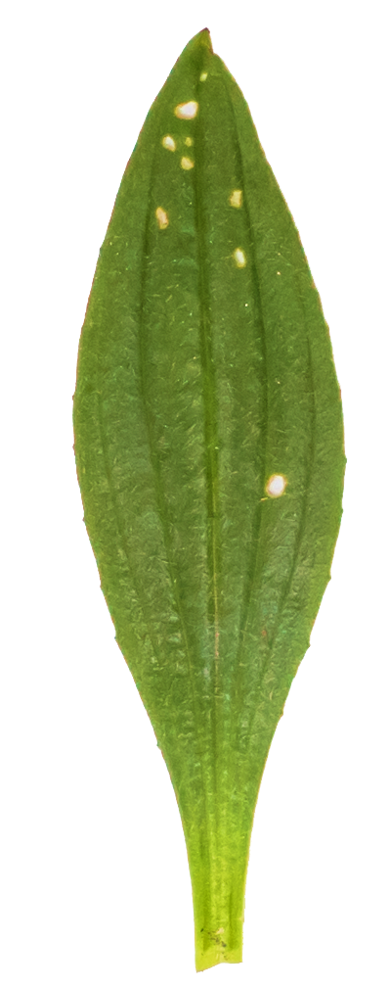
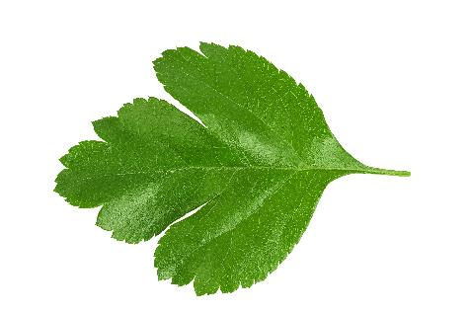
Leaf bases
Round | Heart-shaped | Pointed | Tapered

Slide 16



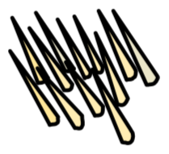

Leaf textures
Word | Symbol | Example leaves
Soft |  | baby spinach
Smooth |  | bay leaves
Tough |  | chard, kale
Word | Symbol | Example leaves
Fuzzy |  | sage
Prickly |  | holly, thistles

Slide 17
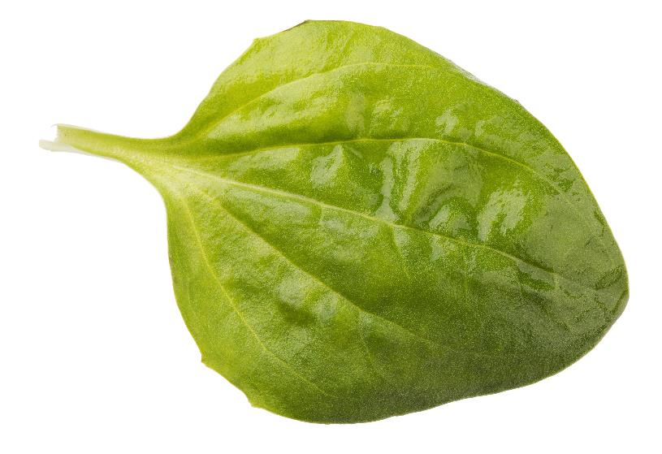
Put together a description of this leaf
This leaf is simple.
The shape is oval.
The tip is round.
The edge is smooth.
The base is smooth.

Slide 18

It’s okay to use more than one word for each part of the leaf
This leaf is simple.
The tip is round.
The edge is lobed and serrated.
The base is round on the left and tapered on the right.

Slide 19
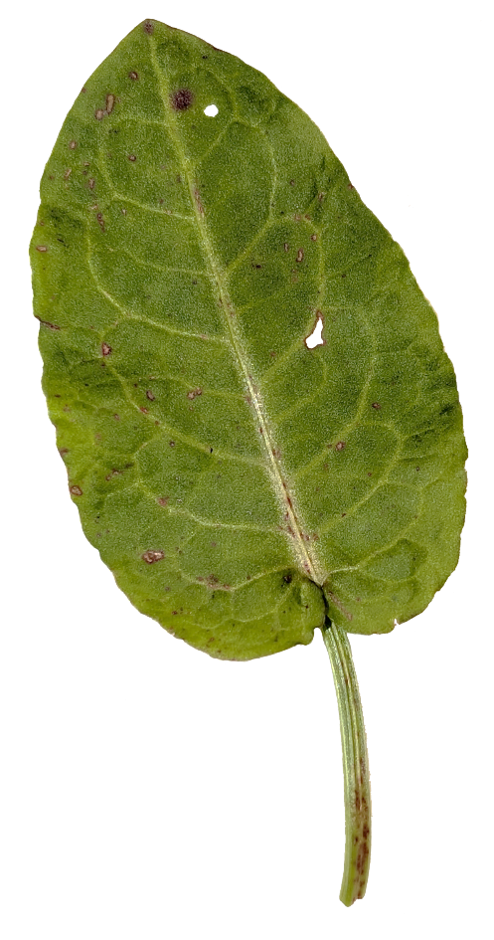
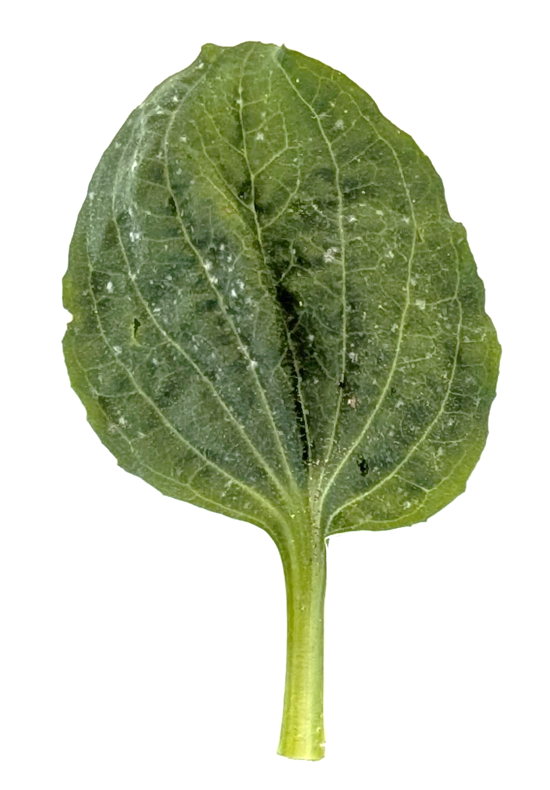
Describe as many differences as you can
Dock leaf
Greater plantain leaf

Slide 20
Use our new leaf vocabulary to write one description that works for all three leaves

Slide 21
Extra detail

Slide 22
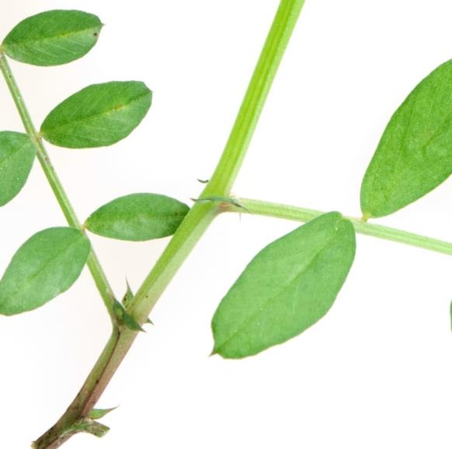
Leaf or leaflet?
To tell where a leaf starts, look at where the broad part of the leaf meets the stalk.
Leaves usually have a lump where the leaf stalk meets the stem.
This lump is a bud.
Bud
No bud

Slide 23
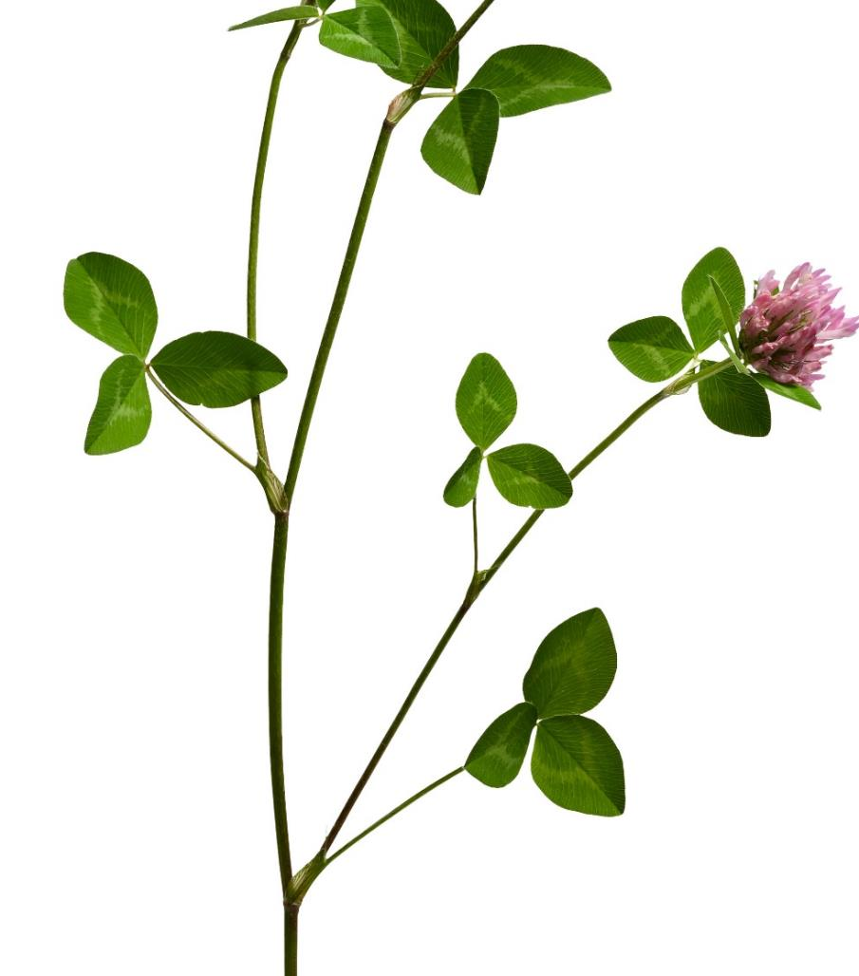
Leaf or leaflet?
No bud
Buds grow into new stems or flowers.
Leaflets do not have buds where they meet the stalk of the leaf.
Bud grown into a new stem.

Slide 24
Activity ideas

Slide 25
Describe and draw
Organise learners into pairs or small groups.
Each student draws their own imaginary leaf. They should keep this hidden for now.
Learners take turns describing their leaf. Other students draw a leaf according to the description.
When all learners have had a turn to describe their leaf, learners reveal what they have drawn and compare results.
Learners reflect on how they described their leaf and how their description was interpreted. How could they change their description to produce a more accurate result?
Notes:
Alternatives
Learners could select a real leaf or photo of a leaf and describe it for their partner.
Do the activity before learning leaf vocabulary. Repeat the activity afterwards using their new vocabulary.
Learners can reflect on if their drawings match more closely at the start or end of the session.

Slide 26
Searching or prompting
Even with modern technology, search terms and AI prompt engineering are important skills that require the use of detailed descriptive vocabulary. Here are two ideas for practising these skills and using leaf vocabulary.
Type a description of a leaf into a search engine.
Does it return results that look like the leaf they have drawn?
Input the description for a leaf into a generative AI model.
Does it generate a leaf image that looks like your leaf?

